Slide 1

Programming and Data Visualization for Researchers PSY-3035 HEL-8048
James McCutcheon
IPS / Helsefak

Slide 2

Format and expectations
Workshop format
Highly interactive – lots of opportunities to discuss and ask questions
Preparation for each workshop will be some reading/watching/coding
1-2 mini-lectures per workshop, in scheduled hours (14:15-16:00)
Time for independent coding and help in final, unscheduled hour (16:00-17:00)
Expected to work for some hours (at least 8 h) in between classes

Slide 3

Canvas

Slide 4
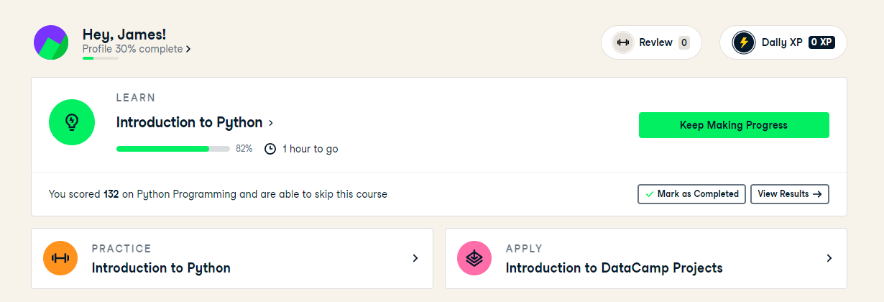
Datacamp
Introduction to Python fundamentals
Can also learn R in similar way
Able to test your progress as you go
https://www.datacamp.com/

Slide 5
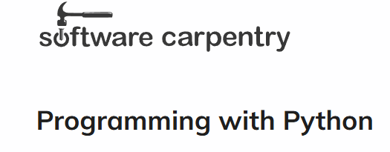
Software Carpentry
Introduces concepts and is focused on data analysis
Includes plotting and goes further than Datacamp in the skills we will use
Many other courses available as well as “real-time” lessons
https://swcarpentry.github.io/python-novice-inflammation/

Slide 6

Arbeidskrav
To pass the arbeidskrav…
You need to attend at least 80% of the workshops
You need to take a test of Python skills

Slide 7
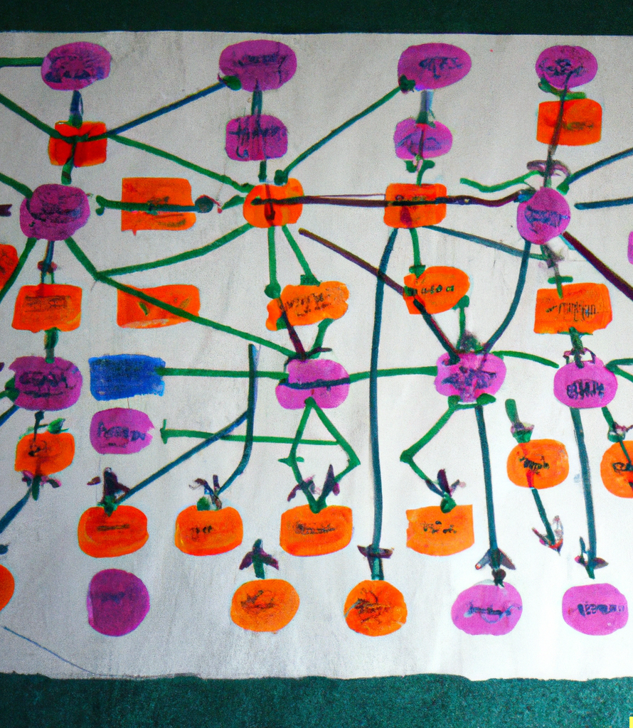
Exam
For the exam you will create a project using data of your choosing
The project must…
…be uploaded in an online form
…produce interesting data visualizations
…include documentation
Much more detail will be provided in a later workshop and on Canvas

Slide 8

Why learn to code?
Save time / automate analysis
Allow more interesting/sophisticated analysis
Open up career prospects
It’s fun!

Slide 9

My personal coding history
Started coding in my postdoc (c. 2008) to speed up tasks that involved a lot of copy-pasting
VS Basic (Excel) -> Matlab -> Python
Version control (Github) to keep things tidy
Use for all graphs and figures
Have been teaching students and postdocs in my lab since c. 2015
Teaching coding in a class format since 2022 (but also adapting due to e.g., AI agents etc…)

Slide 10

Why use Python?
Advantages
Very popular widely used – lots of help online
Incredibly flexible
Relatively easy (not as strict as other languages)
Readable
Disadvantages
Not as easy to do statistics as R
Not as fast for big computations as some other languages

Slide 11

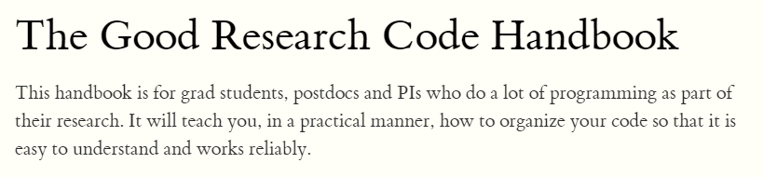

Pensum

Slide 12
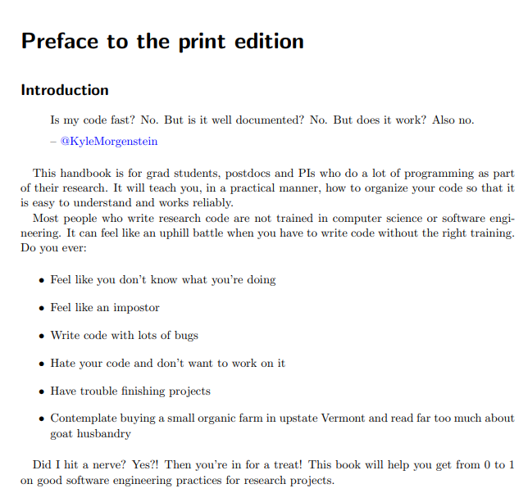

Slide 13
ChatGPT (and other AI tools)
Has replaced Stack Overflow as the best simple source of coding advice
You still need to know how to code to make sure it is doing what you want it to but it can save a lot of time
Use it iteratively – if it doesn’t give you what you want first time, ask it again, or tell it what is wrong
Github Copilot is better than vanilla ChatGPT and can interact directly with your code – can get it free as a UiT student by signing up to Github Education

Slide 14

COFFEE TIME

Slide 15

Installing Anaconda
Anaconda is a distribution of Python that includes Python and some other useful tools
Jupyter Notebook / Jupyter Lab
Spyder
Numpy
Matplotlib
An important feature is that it lets you keep different projects organized by creating different environments for different projects

Slide 16
Steps for installation
Search for “anaconda install” or go to https://docs.anaconda.com/anaconda/install/index.html
Click on the appropriate installation OS, e.g. Installing on Windows
Download the Anaconda installer and follow instructions
Do NOT install as Administrator

Slide 17



IDEs and Notebooks
IDE (Integrated Developer Environment)
Makes it easy to write and organize your code
Spyder is the one that comes bundled with Anaconda
Visual Studio Code is my favourite
Others available e.g., PyCharm, Rstudio (for R)
Notebooks
Jupyter Notebook (and Jupyter Labs) is bundled with Anaconda
Allow you to run code in «cells» (e.g. one block at a time)

